Slide 1

STEAL
THIS
BRAND

Slide 2










Slide 3
WHAT IS A
BRAND?

Slide 4
WHAT IS A
BRAND?
Something applied to an average thing to
make it seem more special
A logo, tagline, mission statement, etc.
An ‘aspirational’ stake in the ground and the
tools and rules that enable
average people to do genius-level work

Slide 5
WHAT DOES
BRANDING & MARKETING COST?

Slide 6
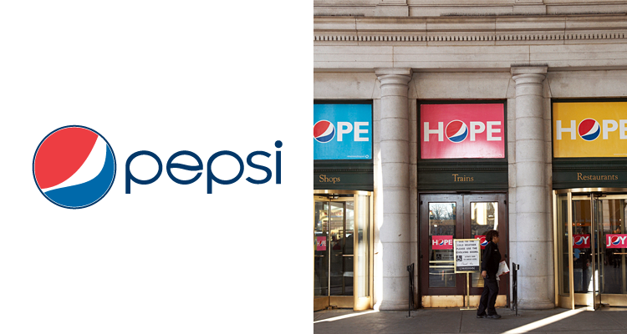

Slide 7
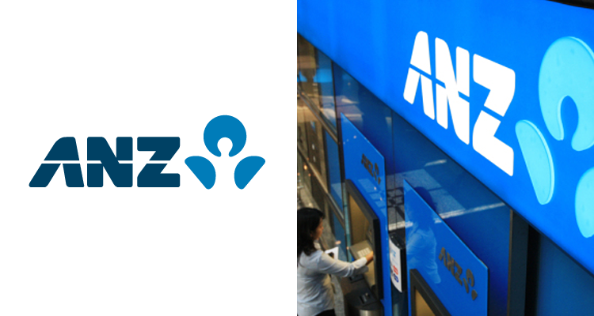

Slide 8


Slide 9
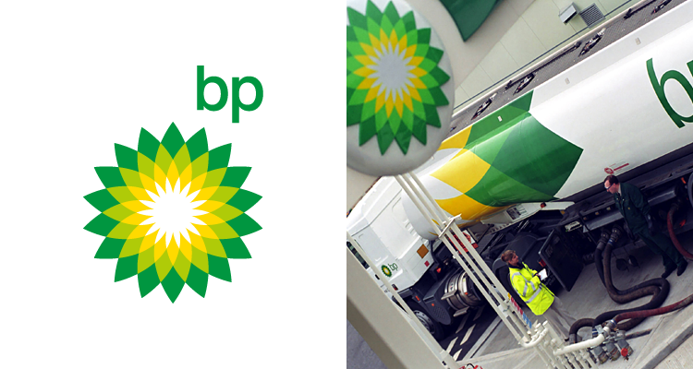

Slide 10


Slide 11
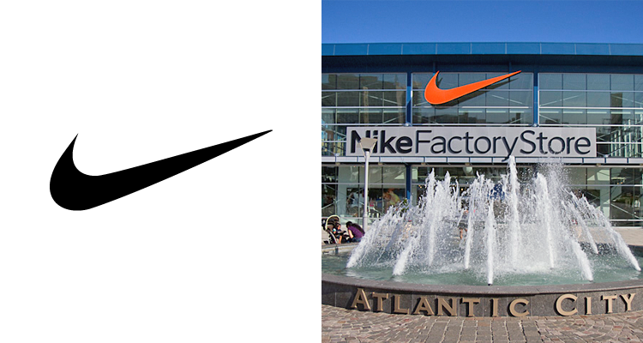

Slide 12
FREE!

Slide 13
We’re going to
use social media.
We’re going to make a viral video.

Slide 14
Relying on VIRAL VIDEOS to promote your brand is like using the LOTTERY to pay your bills

Slide 15
Social media is not PAID MEDIA,
it is EARNED MEDIA

Slide 16
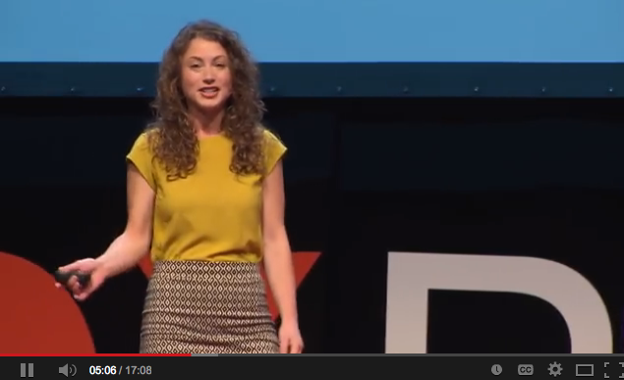

Slide 17

KICKSTARTER
TED TALK
VIRAL VIDEO
NEWS STORIES
SOCIAL MEDIA

Slide 18
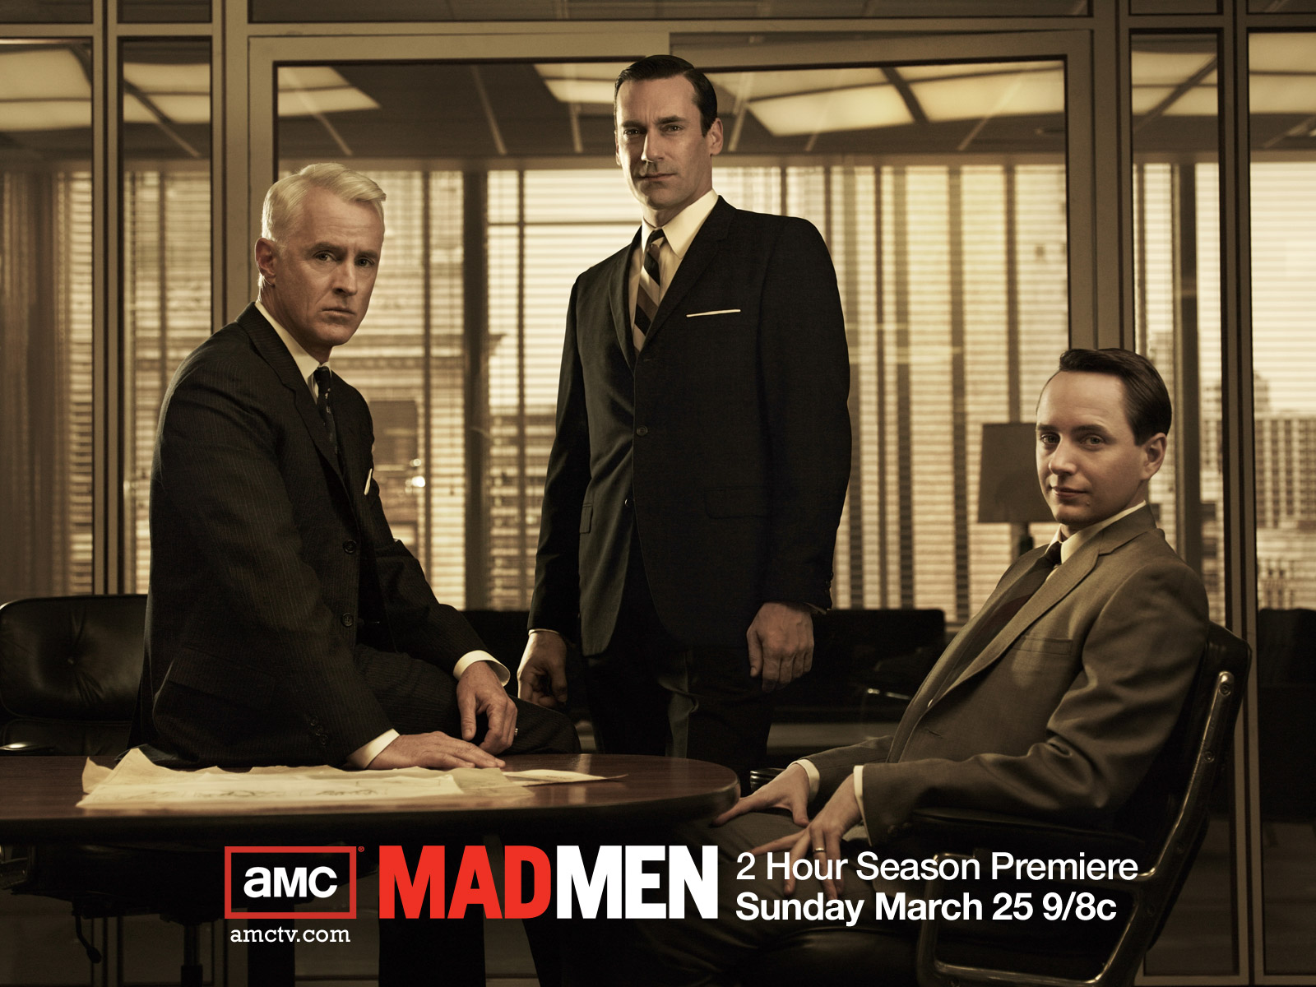

Slide 19
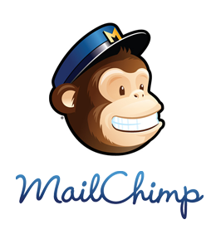



Slide 20


Slide 21
What Can Marketers Exploit?
Best Price, Special Deals and Risk-Free Purchase
Exotic, Taboo and the (Seemingly) Dangerous
Expert Study or Endorsement
Celebrity Status
A Political or Social Cause or Controversy
Our “Maslowsian” Needs
  Physiological – multiple brands and store brands, no risk – money-back guarantees, fair and clear pricing, sales and special offers, suggested sales …
  Safety, love/belonging and esteem – through adoptable brand stories that signal our tribal identity and establish or reinforce our social status
  Self-actualization, transcendence and forgiveness

Slide 22
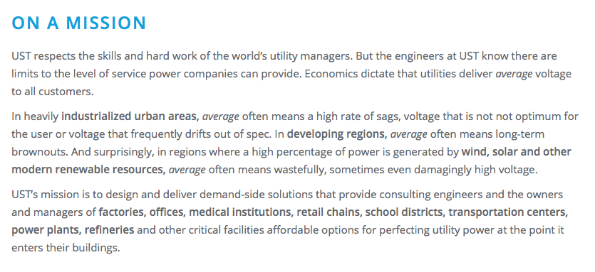

Slide 23
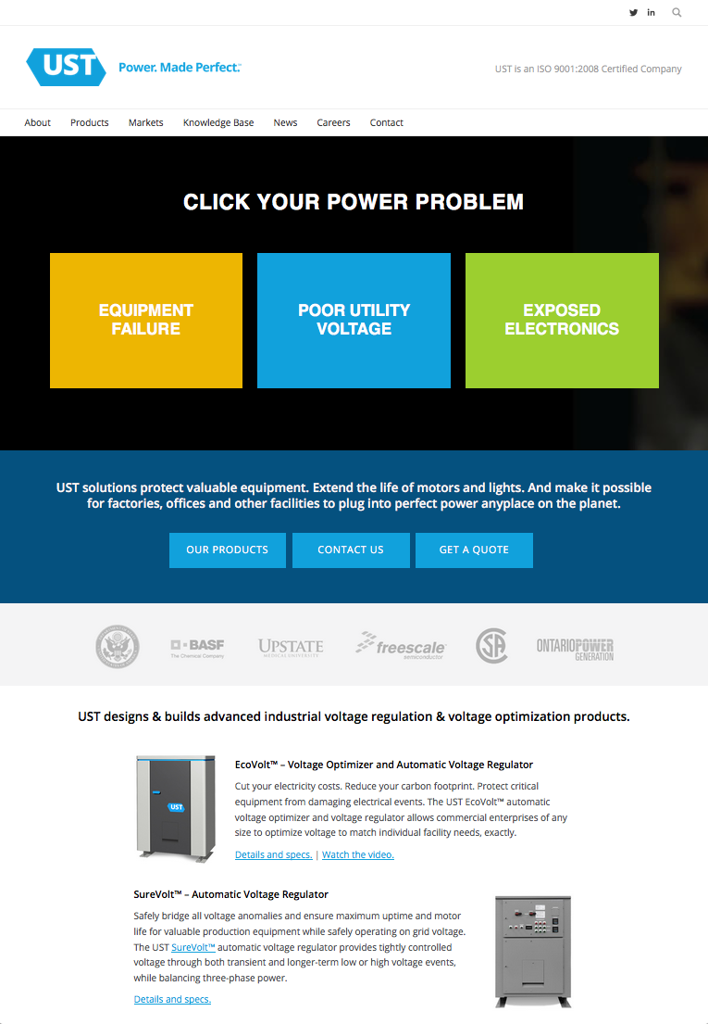

Slide 24
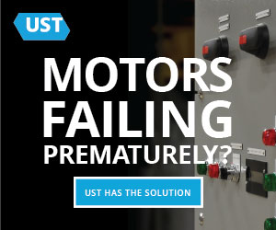



Slide 25
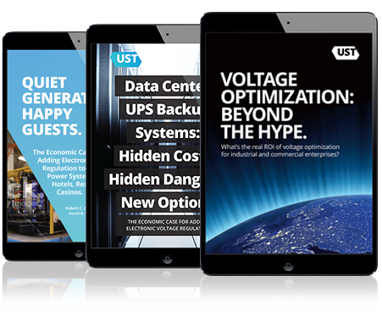

Slide 26
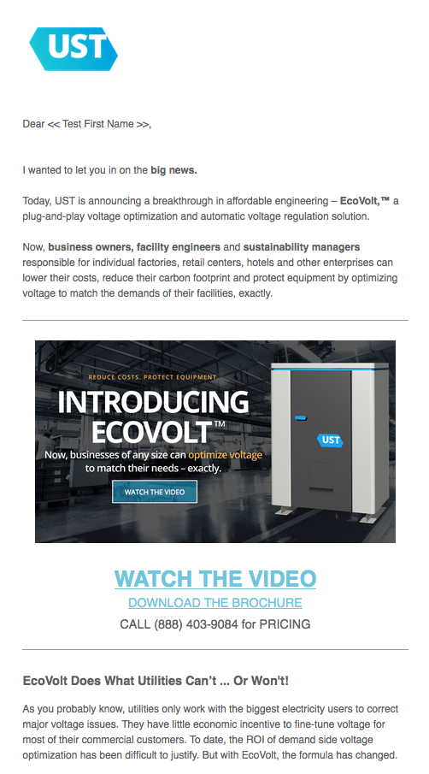

Slide 27
Branding Plan
Name (with a good url)
Logo and graphic standards
Tagline and catch phrases
Social mission

Slide 28
Platform Plan
Website and lead capture
Email and digital marketing
Sharing and Sampling – applications, high-value content, events, trial product/free product
Stakeholder development – social media, donation opportunities
Sponsorships –think of paid media as a form of sponsorship
Analytics

Slide 29
Marketing Process Plan
Set a budget
Establish a process
Put it on a schedule
Stick to the schedule

Slide 30
